Slide 1


Big Companies and COVID-19
MaNaKeAn January 16, 2021

Slide 2
Objective
In general, the stock market spent the last four years on an upward trajectory.
However, COVID-19 disrupted the economy in ways no one predicted.
Our plan: Evaluate two random stocks in five different industries to see if, and how they were impacted.

Slide 3










LOGISTICS
RETAIL
AUTO INDUSTRY
AIRLINE
SOCIAL MEDIA
10
random companies in
5
different markets

Slide 4
Data Source
Yahoo Finance
Downloaded historical stock data for each company
Daily closing prices
Sliced data into the required time periods

Slide 5
Analysis Process
Determined time periods of interest
January 1, 2019 (overview) through December 31, 2020
January 1, 2019 to December 31, 2019
January 1, 2020 to December 31, 2020
Pre-COVID: January 1 to March 1, 2020
Post-COVID: March 1, 2020 to December 31, 2020
Applied calculations
Regressions over several time periods during 2019 and 2020
Percentage daily change
Created charts showing the results

Slide 6
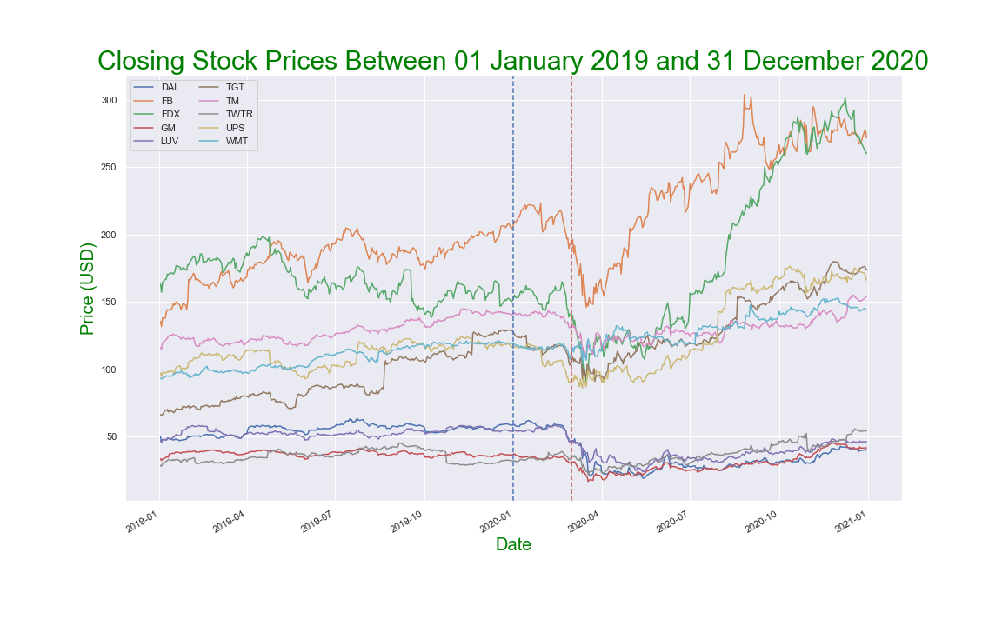
How did each company fare?

Slide 7
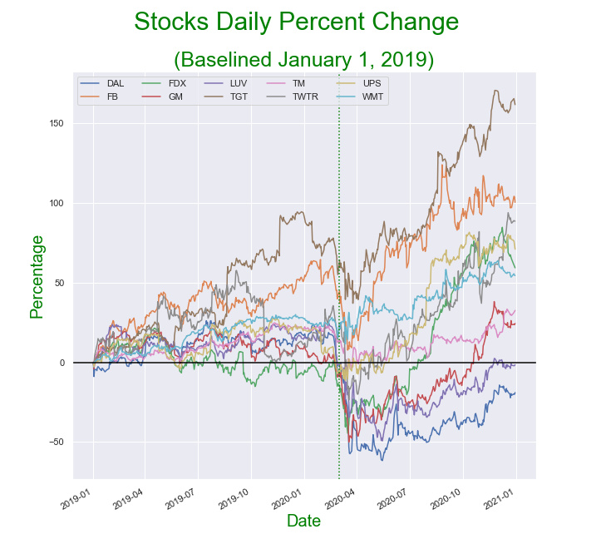
Daily percent change comparisons based on January 1, 2019 stock closing prices

Slide 8
Regression Calculation Approach
By default Yfinance returns data indexed by date column
Reset.index created an additional index numerical column to enable mathematical calculations with the date column
Linear regression was calculated using close price and date. To calculate linear regression, both values had to be numeric but since a date is not, we used .map(dt.datetime.toordinal)” to convert date to Gregorian ordinal to have sequence of number enabling calculating the linear regression.
Also, since we needed to show the linear regression equation as text on the plot, we used “mdates.date2num(dt.datetime(date value))” to print to a specific location in the plot

Slide 9
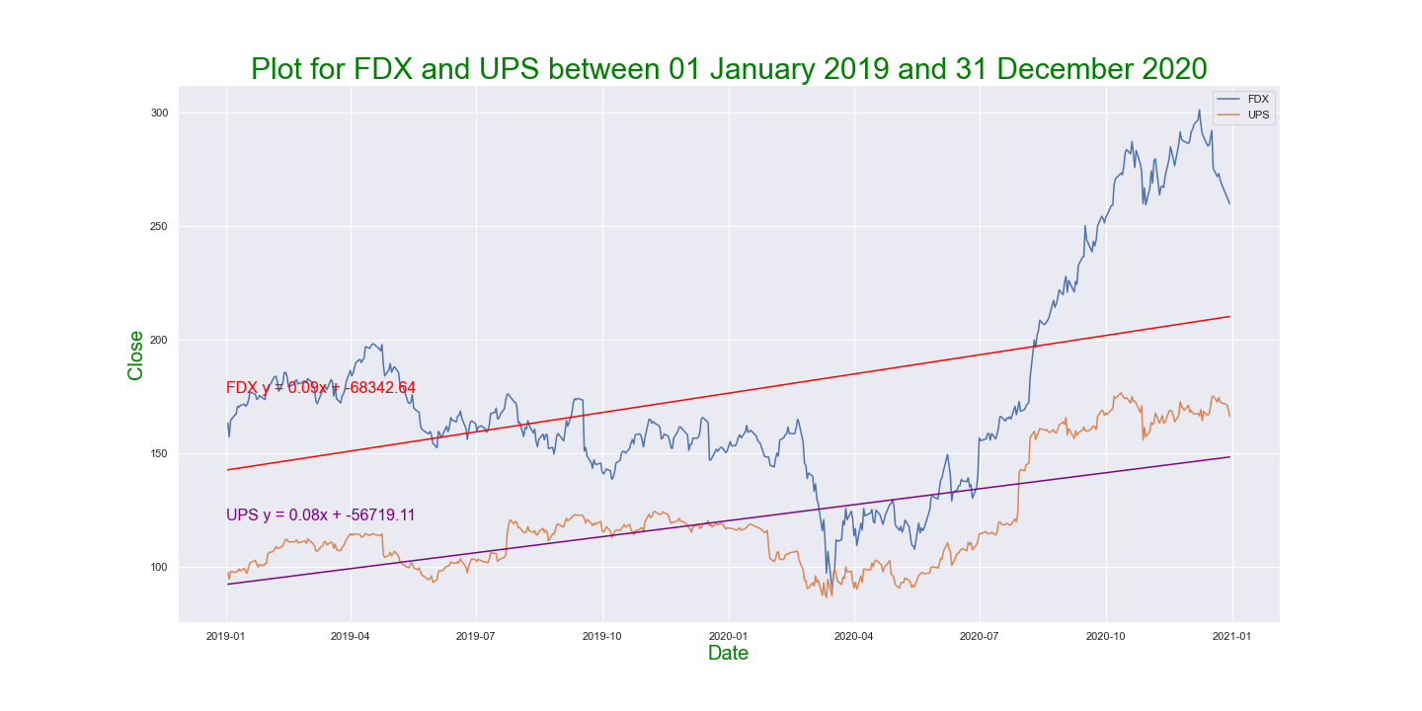
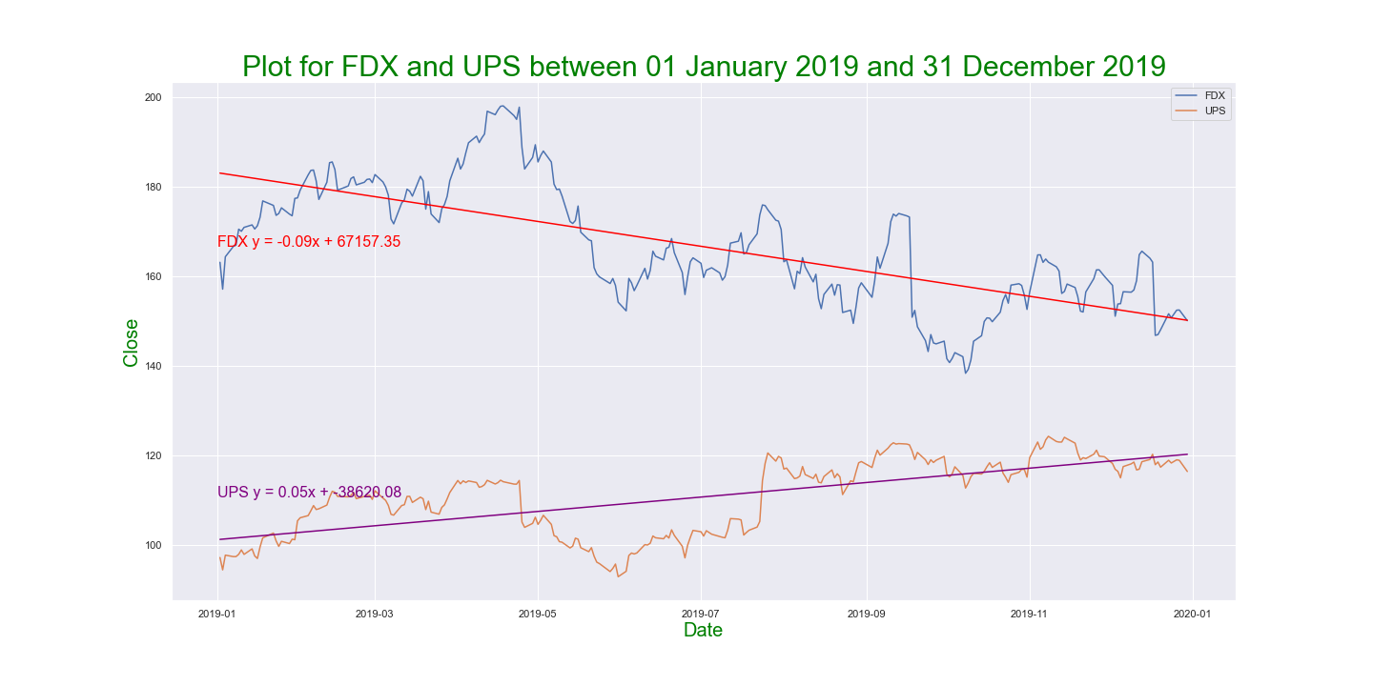
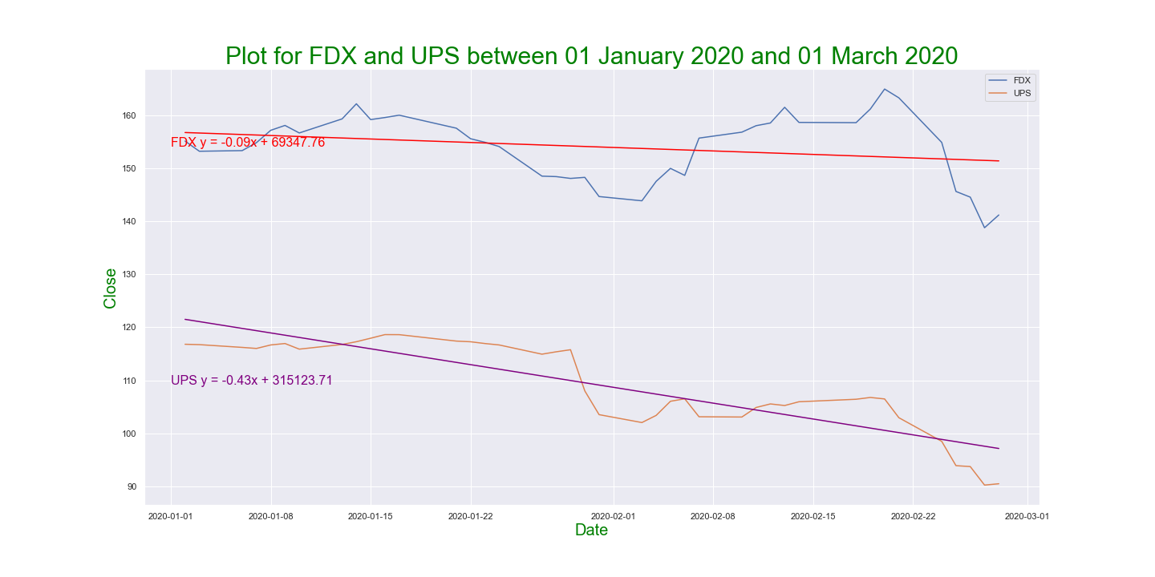
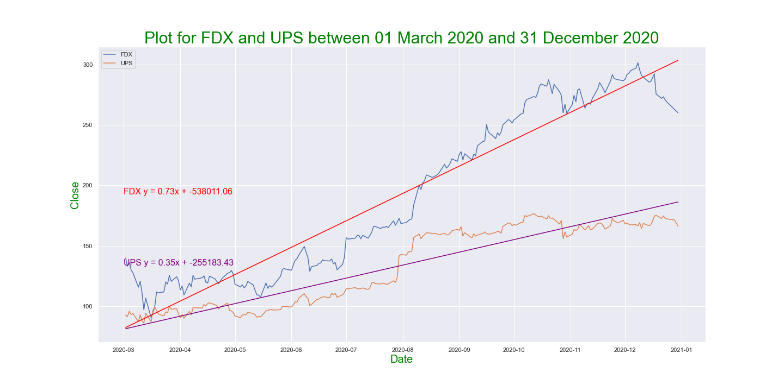
Closing Prices | 2019 and 2020 Regression Review | Logistics

Slide 10
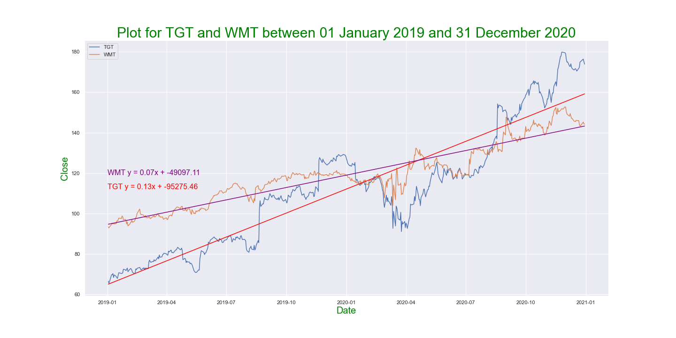
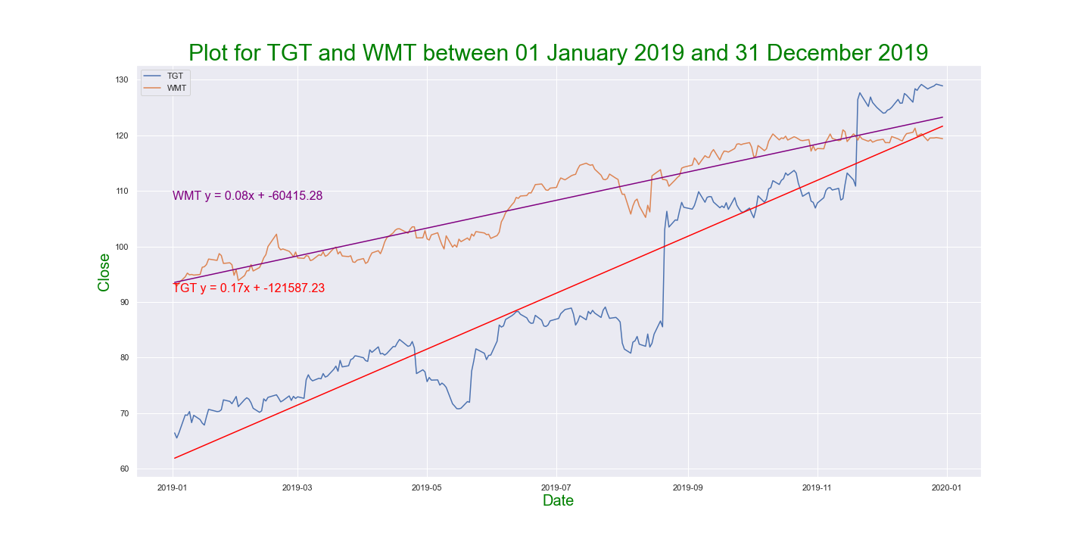
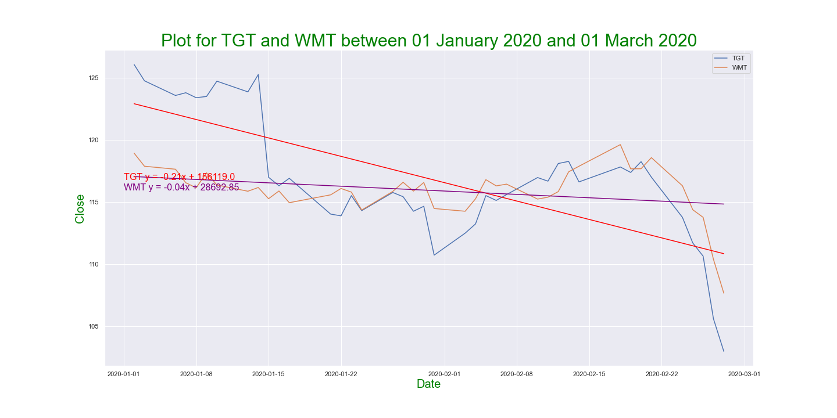
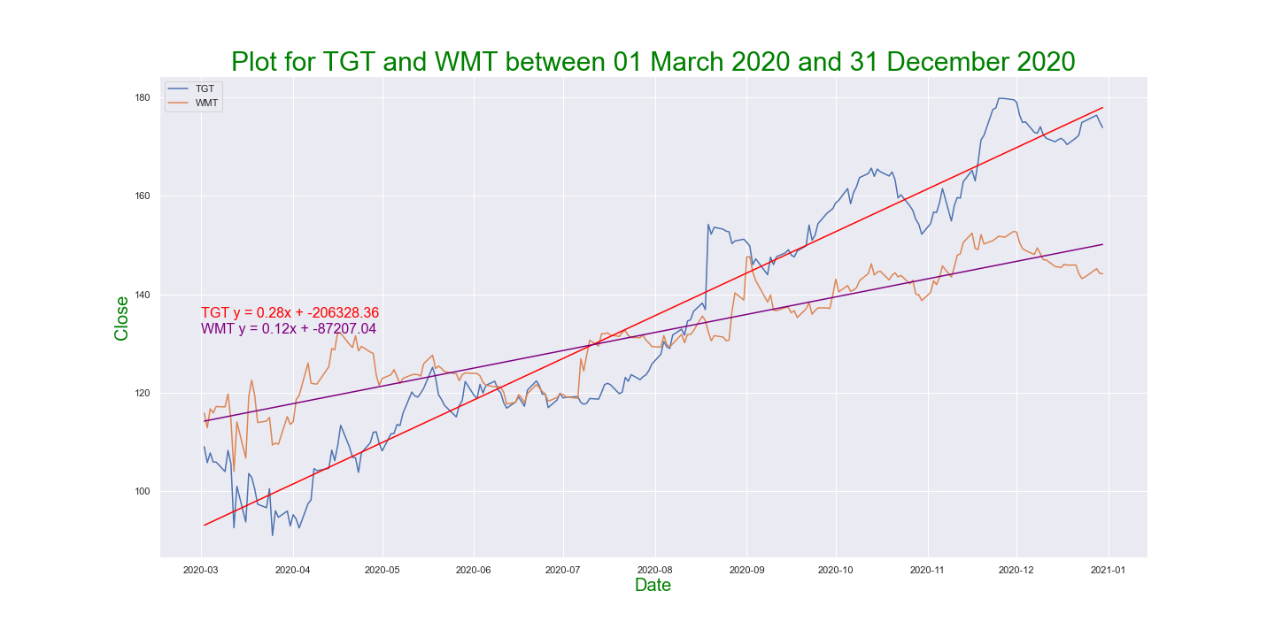
Closing Prices | 2019 and 2020 Regression Review | Retail

Slide 11
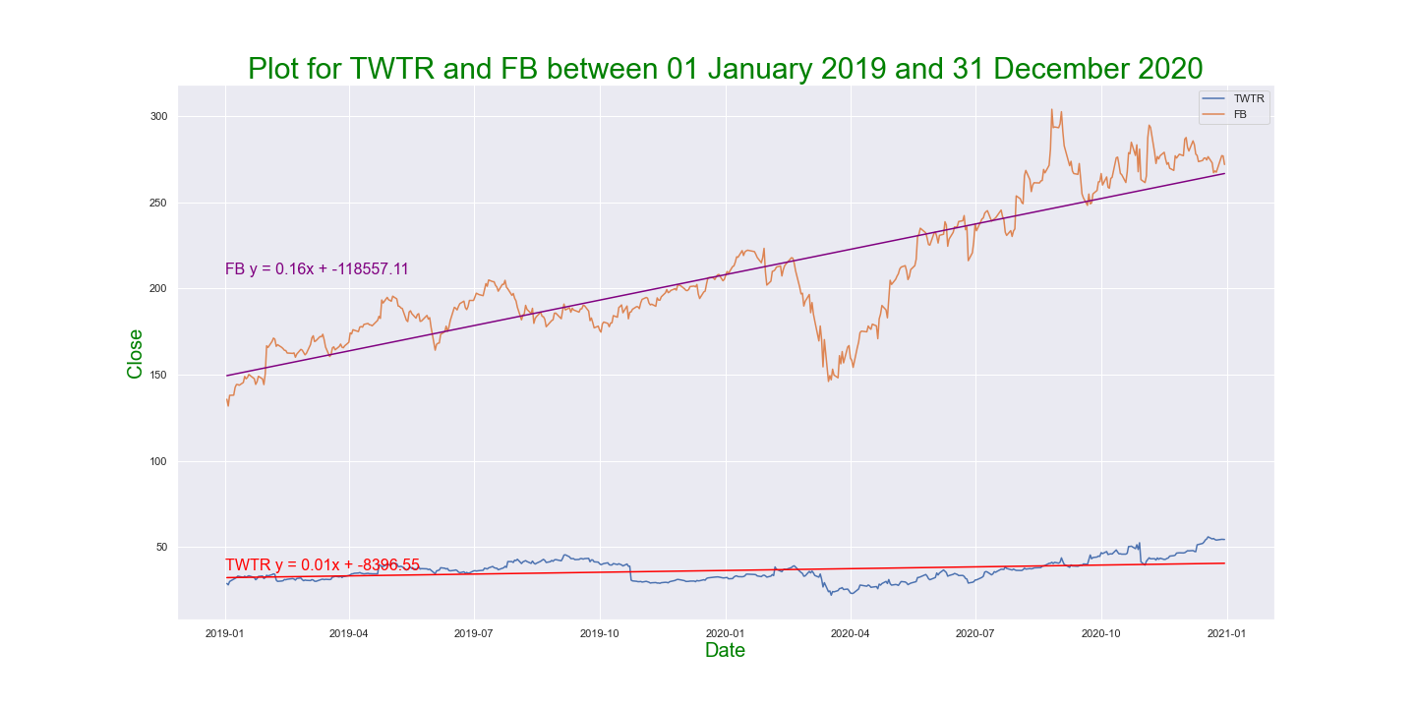
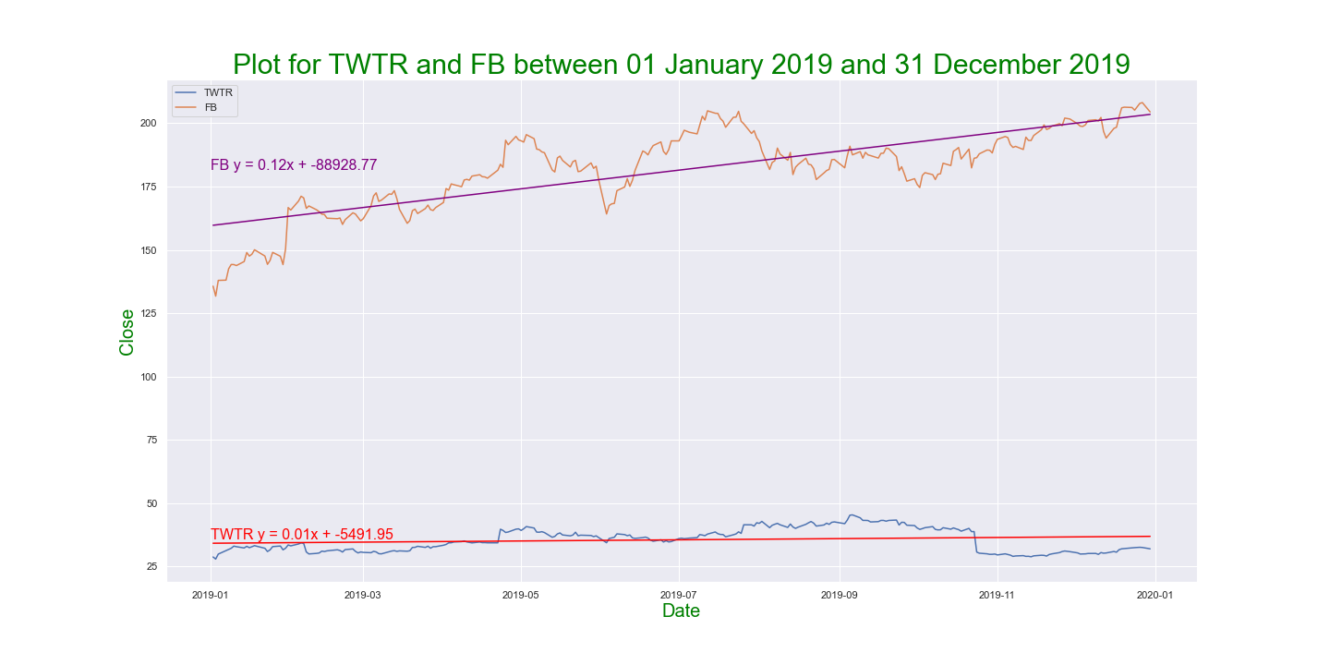
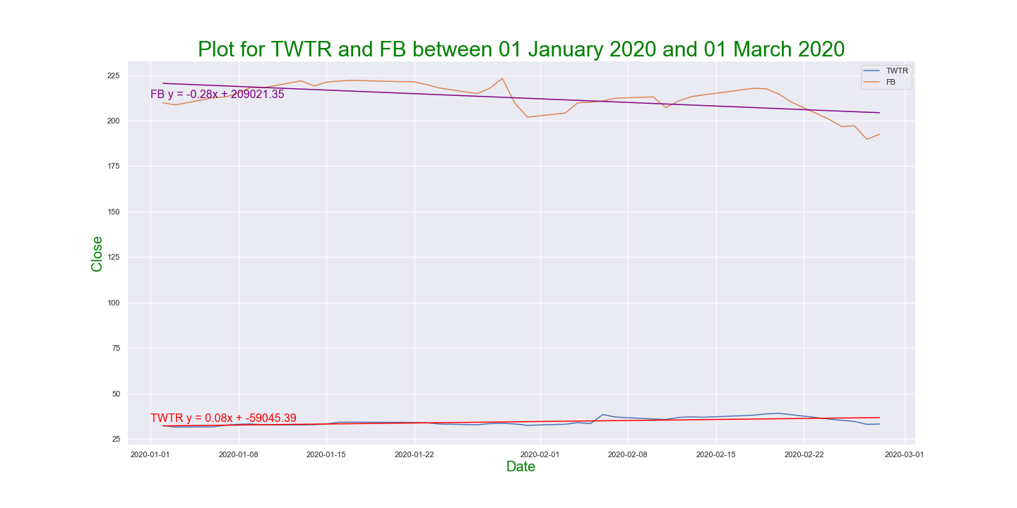
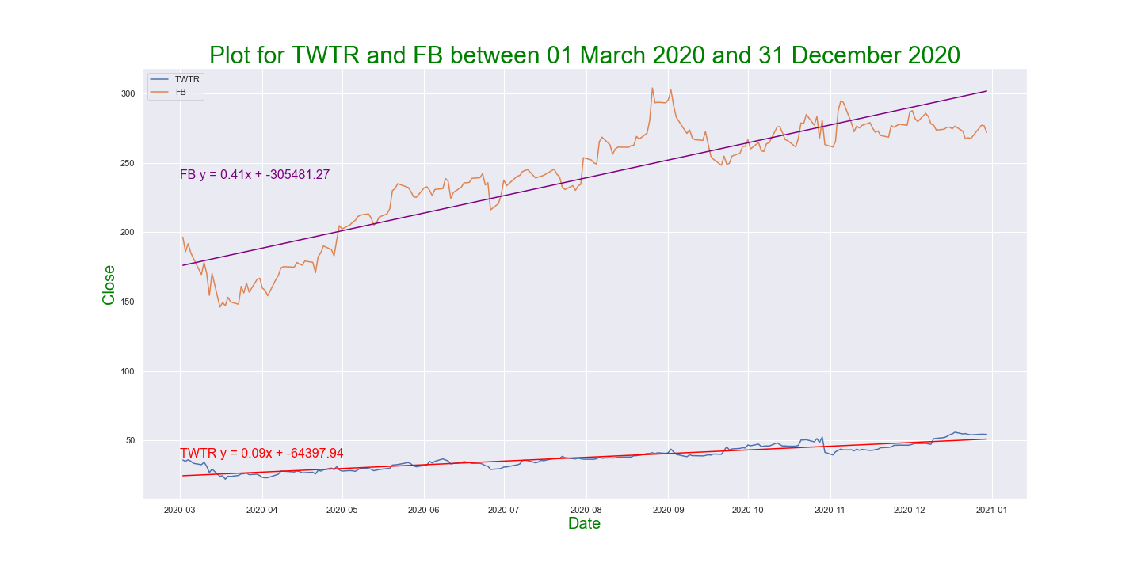
Closing Prices | 2019 and 2020 Regression Review | Social Media

Slide 12
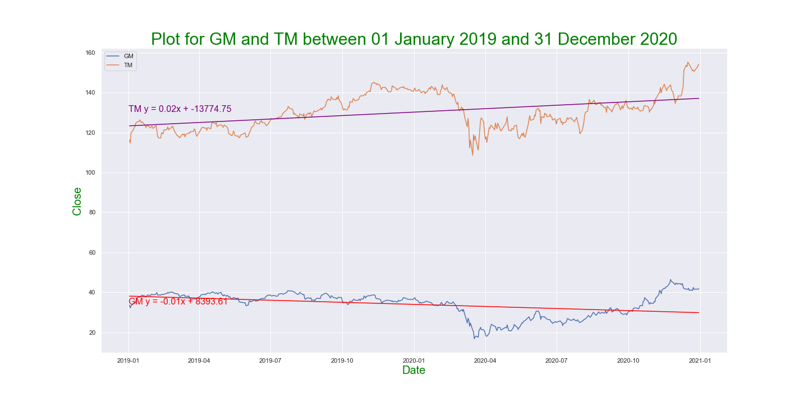
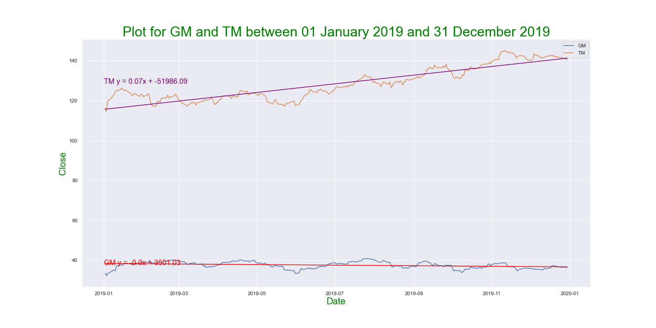
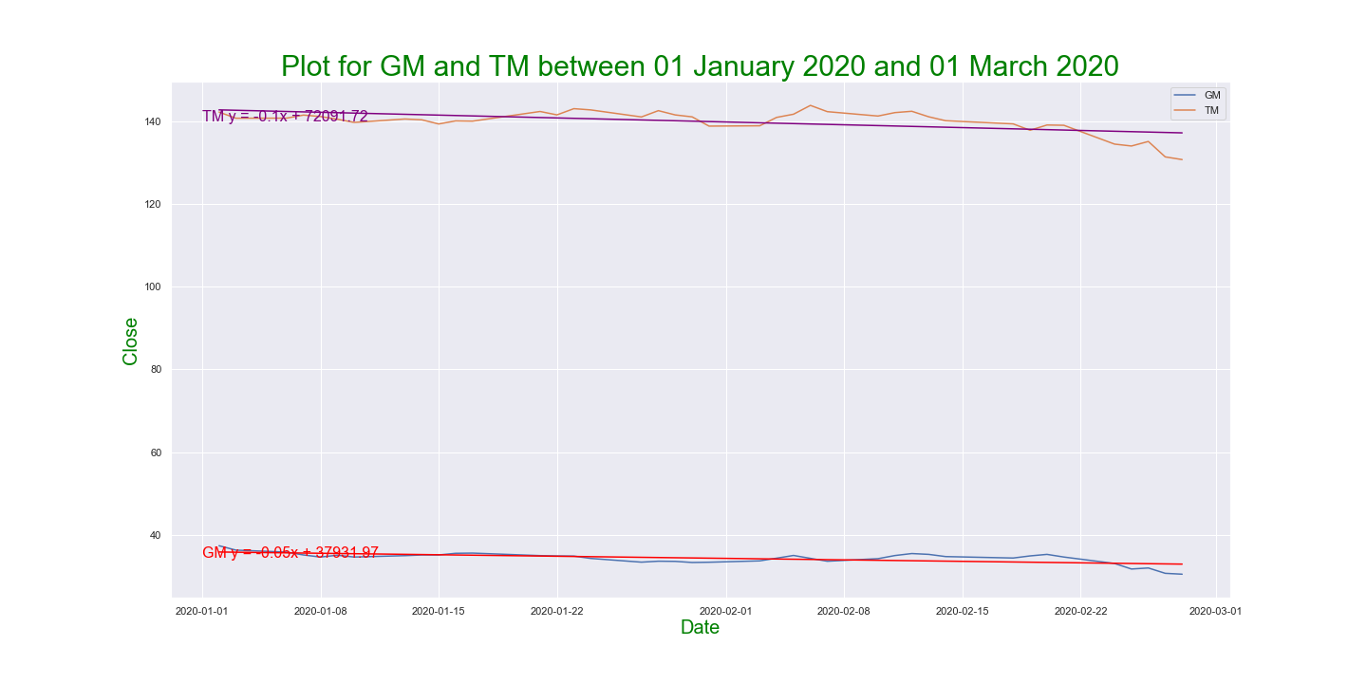
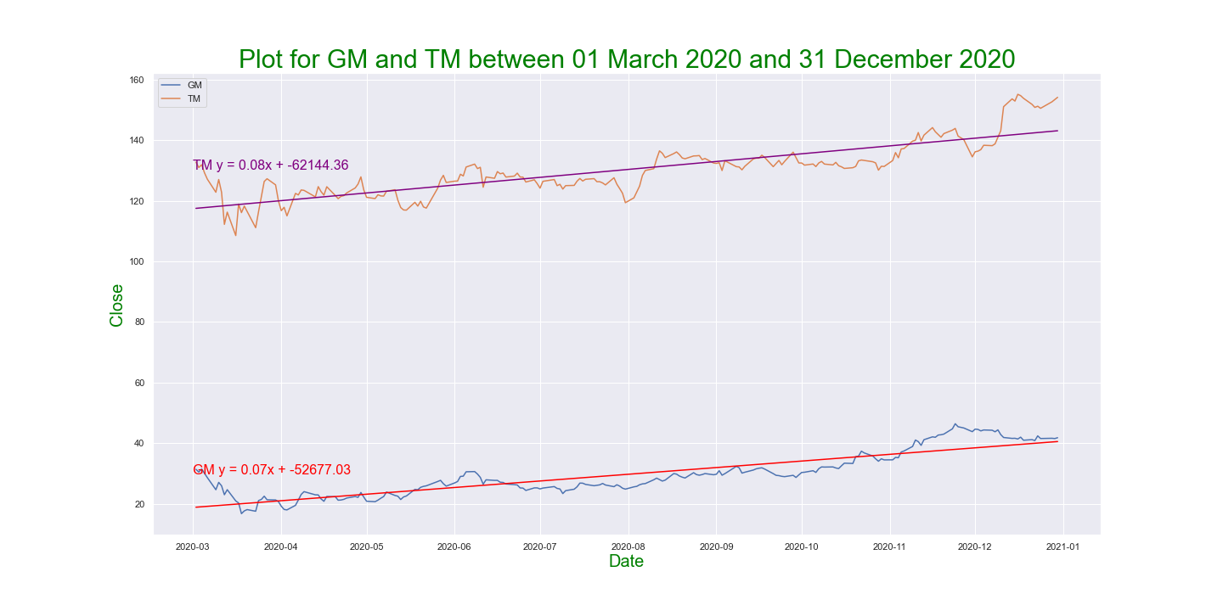
Closing Prices | 2019 and 2020 Regression Review | Auto Industry

Slide 13
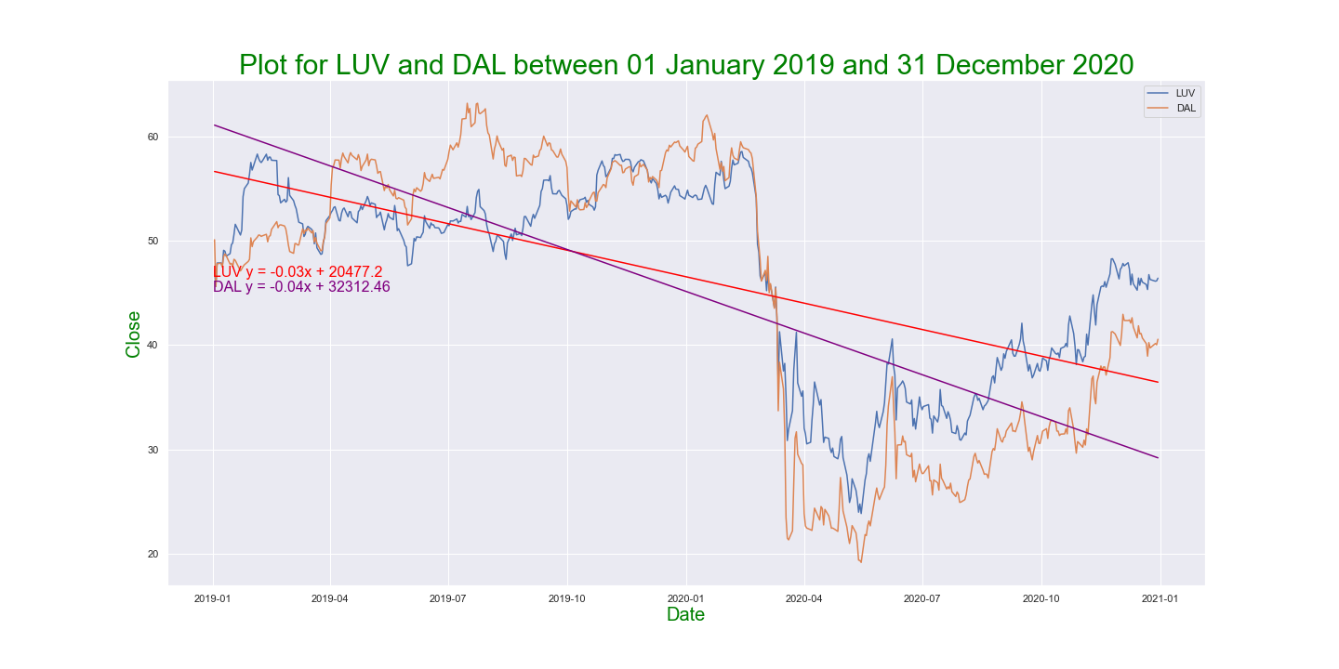
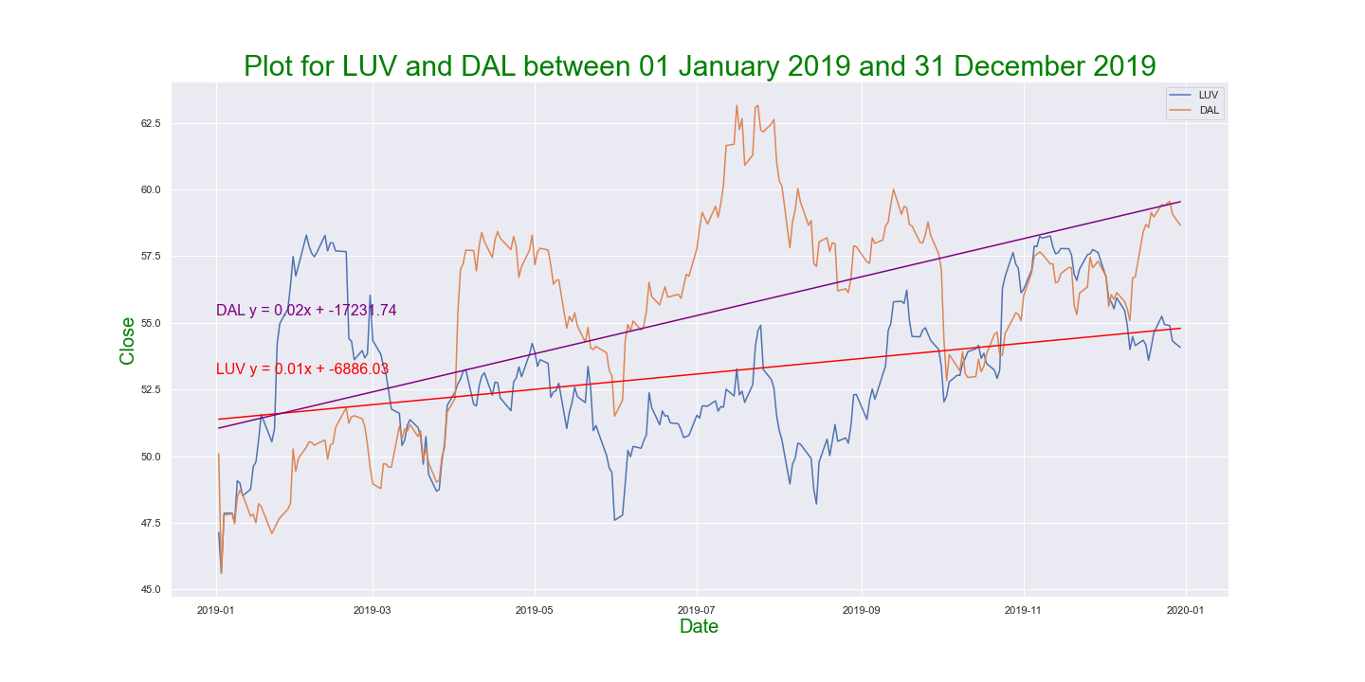
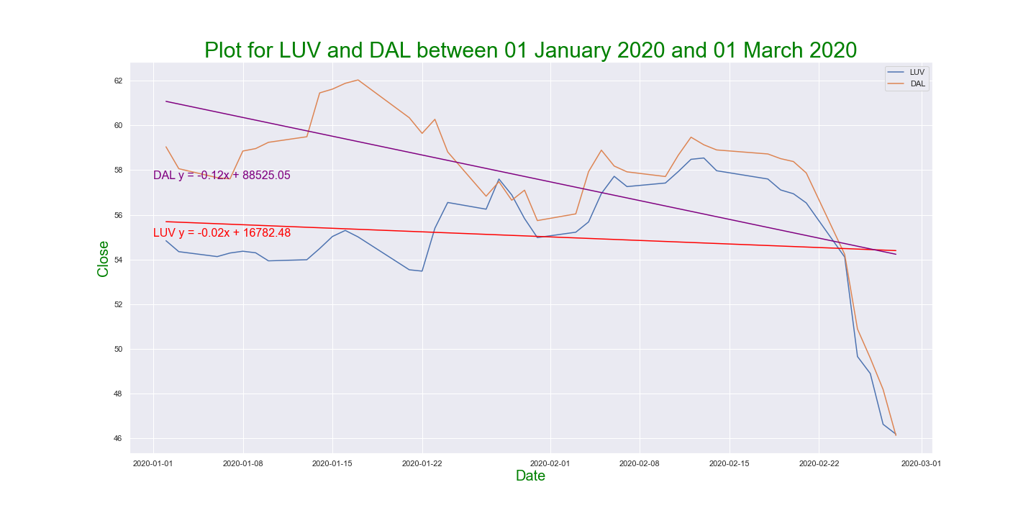
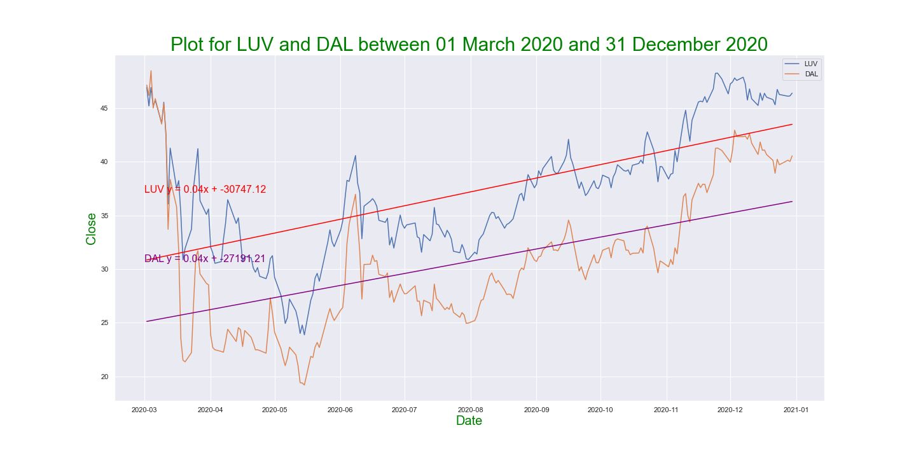
Closing Prices | 2019 and 2020 Regression Review | Airlines

Slide 14
Closing Prices | 2019 through 2020 | Regression Overview
Retail
Logistics
Airlines
Auto Industry
Social Media

Slide 15
Percentage Calculation Approach
The original Yfinance dataframe was converted to daily closing prices by company using the pivot function
A lambda function in combination with a deduction was applied to calculate the daily percent change
dataframe.apply(lambda x: (x / x[0] * 100)-100)
For the plots, a baseline (0% change) line was added as well as a dotted green line indicating the COVID-19 pandemic announcement

Slide 16
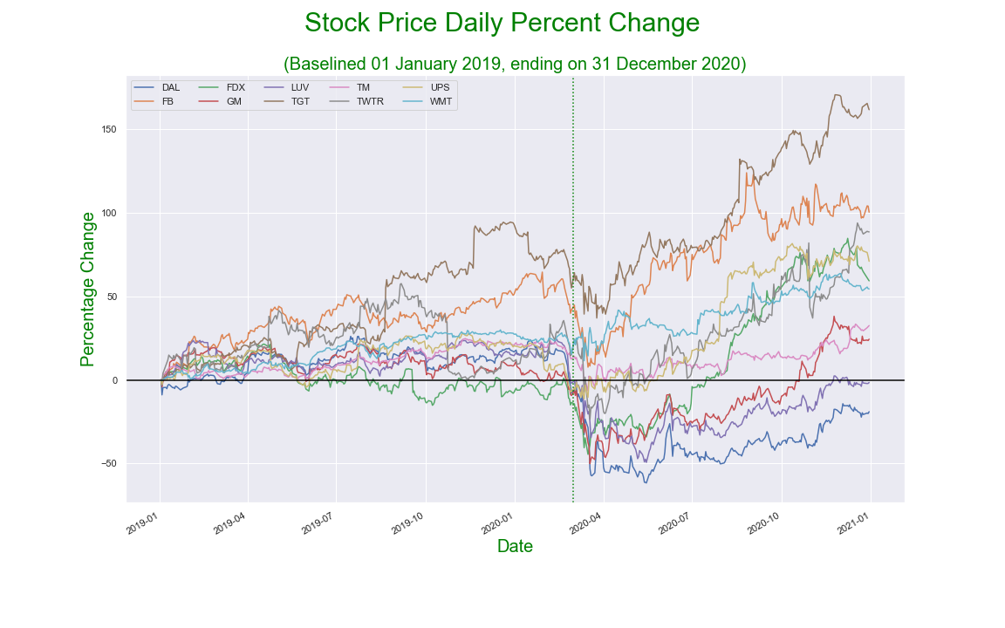
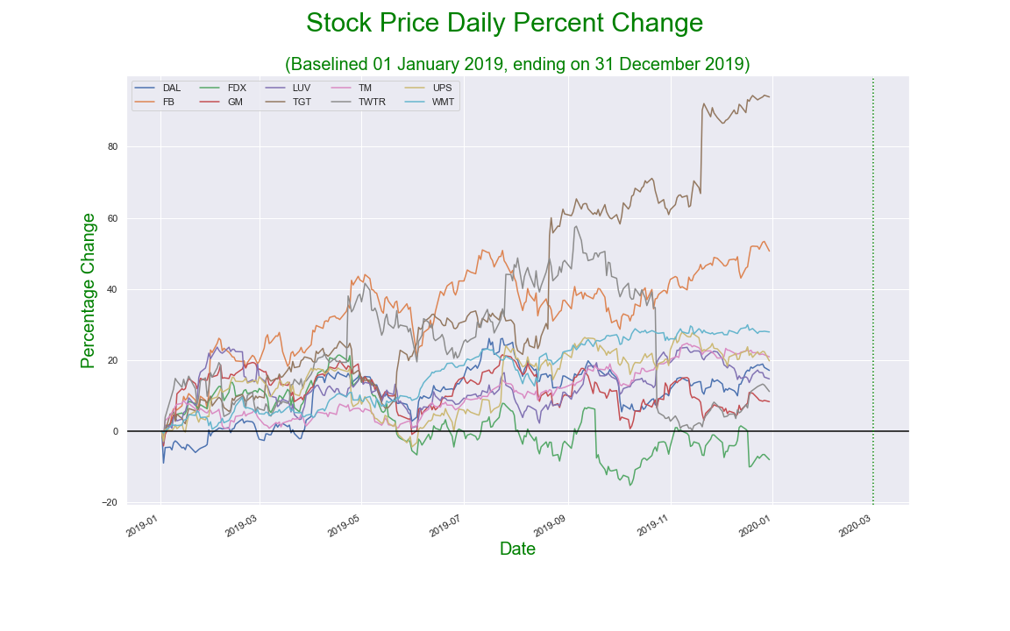
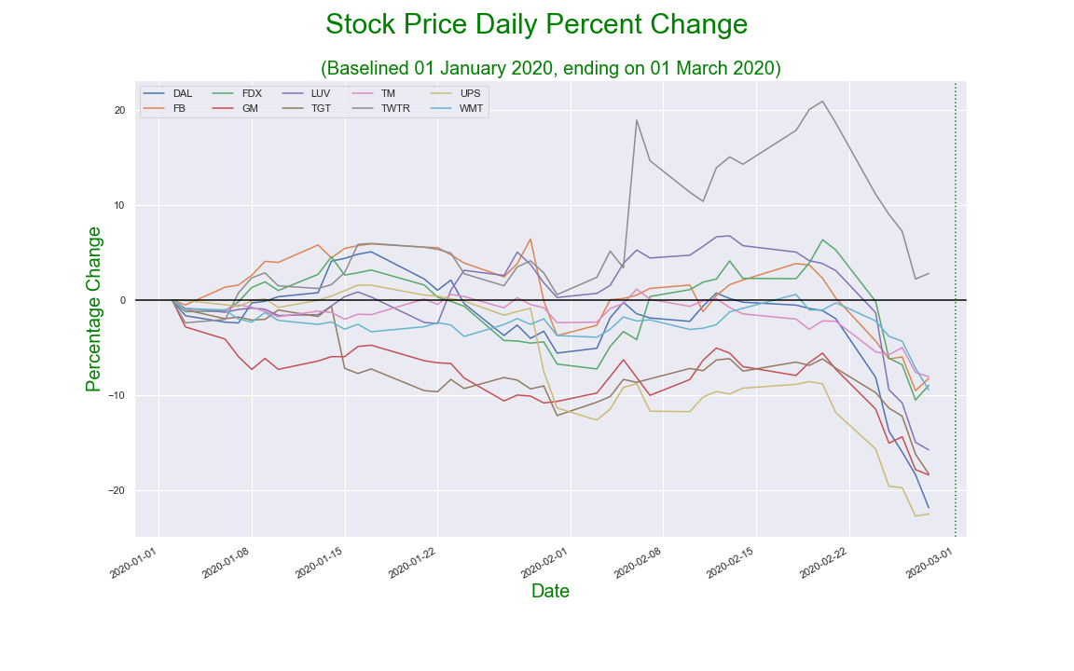
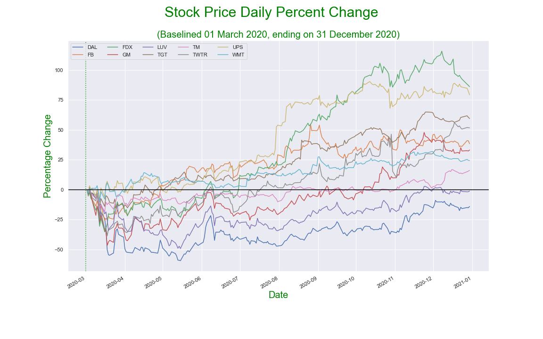
Percent Change during different pre and post COVID time periods

Slide 17
Conclusion
Be smart enough to have most of your assets in cash when there’s a crash*
Buy on the dip
*This is the hard part

Slide 18
Final Conclusions
In 2019 the stock market was mostly doing well. The S&P 500 rose by 29% and the NASDAQ by 35%. Both are commonly accepted market indicators. The DOW ended the year with a 22% gain, making it the best year since 2017.
In 2020, the stock market continued to rise, until March 16th (which is referred to as Black Monday II). The stock market crashed due to the Covid-19 pandemic. Many investors panicked because the world didn’t know what the pandemic could bring. Black Monday II caused a drop of 12% in global markets.
As our understanding of the Coronavirus improved, the stock market began to recover quickly. Most industries recovered their losses, and even made significant gains, except the airline industry, which is still suffering to this day.

Slide 19
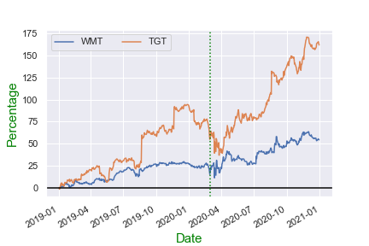
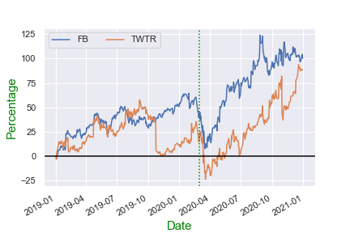
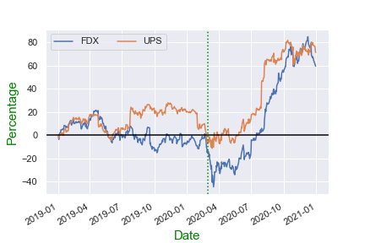
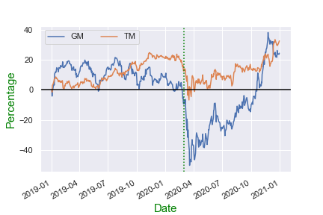
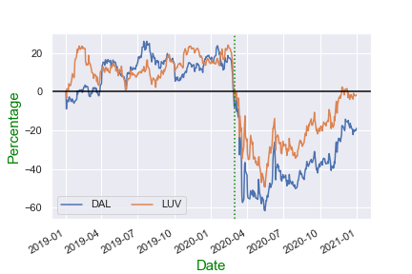
IMPLICATIONS FOR THE STOCKS AND MARKETS REVIEWED
LATE 2020 BIG WINNERS
LATE 2020 STILL RECOVERING

